Slide 1

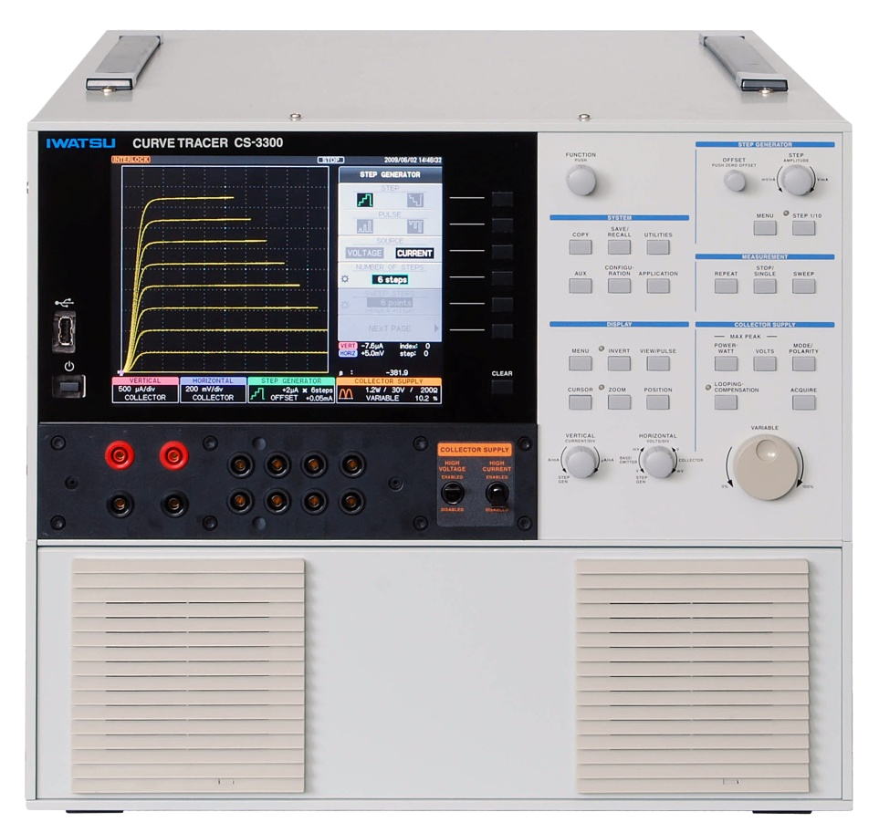
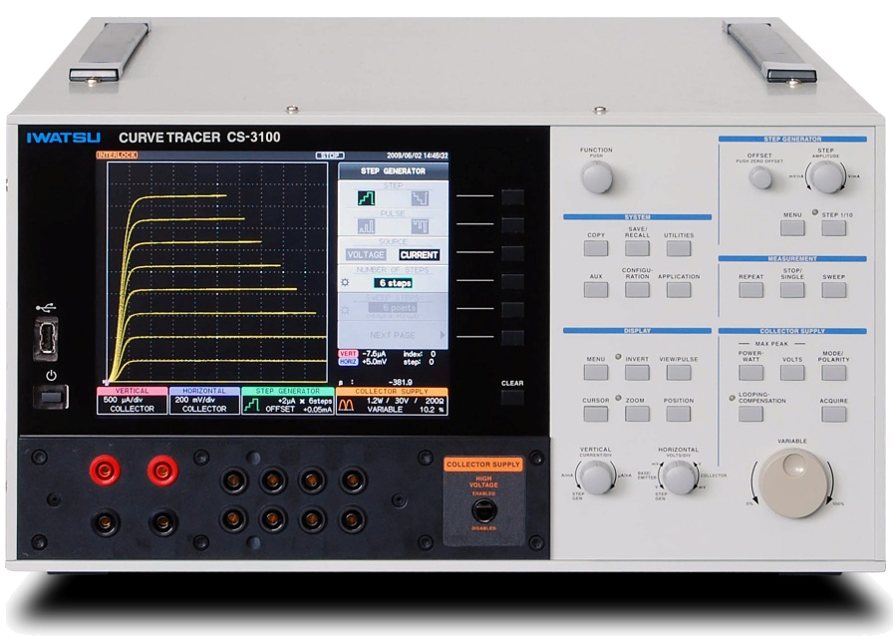
Launching news
Introduction for the semiconductor curve tracer model: CS-3000 series
Suitable for various semiconductor specification measurement such as IGBT, MOS-FET, Transistor, Diodes, etc.
Curve tracer model: CS-3200 & CS-3300
Curve tracer model: CS-3100
Iwatsu Test Instruments Corp.
－ Contribute to development of the power electronics – Curve tracer CS-3000 series

Slide 2
FEATURES of CS-3000 series curve tracers
  ■ Maximum peak voltage at 3,000V（High voltage model）
  ■ Maximum peak current at 1,000A（Large current mode including CS3200 and CS3300）
  ・ ＣＳ-3200（Maximum at 400A）
  ・ ＣＳ-3300（Maximum at 1,000A）
  ■ 4 kinds of Collector supply modes for all models;
  AC, Full-wave rectify, DC & Leakage with 1pA cursor resolution
  ■ USB port for Display hardcopy, Weveform data(CSV format) and measurement setup storage
  ■ LAN interface for Remote control
－ Contribute to development of the power electronics – Curve tracer CS-3000 series

Slide 3
General specification of CS-3000 series curve tracers
 |  |  | CS-3100 |  |  |  |  | CS-3200 |  |  |  |  |  |  |  | CS-3300
Collector supply modes
Mode | High voltage |  | AC, +/- Full-wave rectify, +/-DC & +/-LEAKAGE
 | Large current |  | N.A. |  |  |  |  | Large current mode(with Max. 40Vpulse)
High voltage mode
 |  |  |  |  | Maximum peak current （Maximum peak pulse current） |  |  |  |  |  |  | Maximum peak voltage
 |  |  |  |  | 75mA (150mA) |  |  |  |  |  |  | 3,000V
 |  |  |  |  | 750mA (1.5A) |  |  |  |  |  |  | 300V
 |  |  |  |  | 7.5A (15A) |  |  |  |  |  |  | 30V
Large current mode (only for pulse voltage) |  |  | N.A.
 |  |  |  |  |  |  |  |  |  | Max. peak current |  | Max. peak voltage |  |  |  |  | Max. peak current |  |  | Max. peak voltage
 |  |  |  |  |  |  |  |  |  | 400A |  | 40V |  |  |  |  | 1,000A |  |  | 40V
 |  |  |  |  |  |  |  |  |  | 40A |  | 40V |  |  |  |  | 400A |  |  | 40V
 |  |  |  |  |  |  |  |  |  |  |  |  |  |  |  |  | 40A |  |  | 40V
－ Contribute to development of the power electronics – Curve tracer CS-3000 series

Slide 4

Outer look of the model CS-3200 curve tracer
－ Contribute to development of the power electronics – Curve tracer CS-3000 series

Slide 5
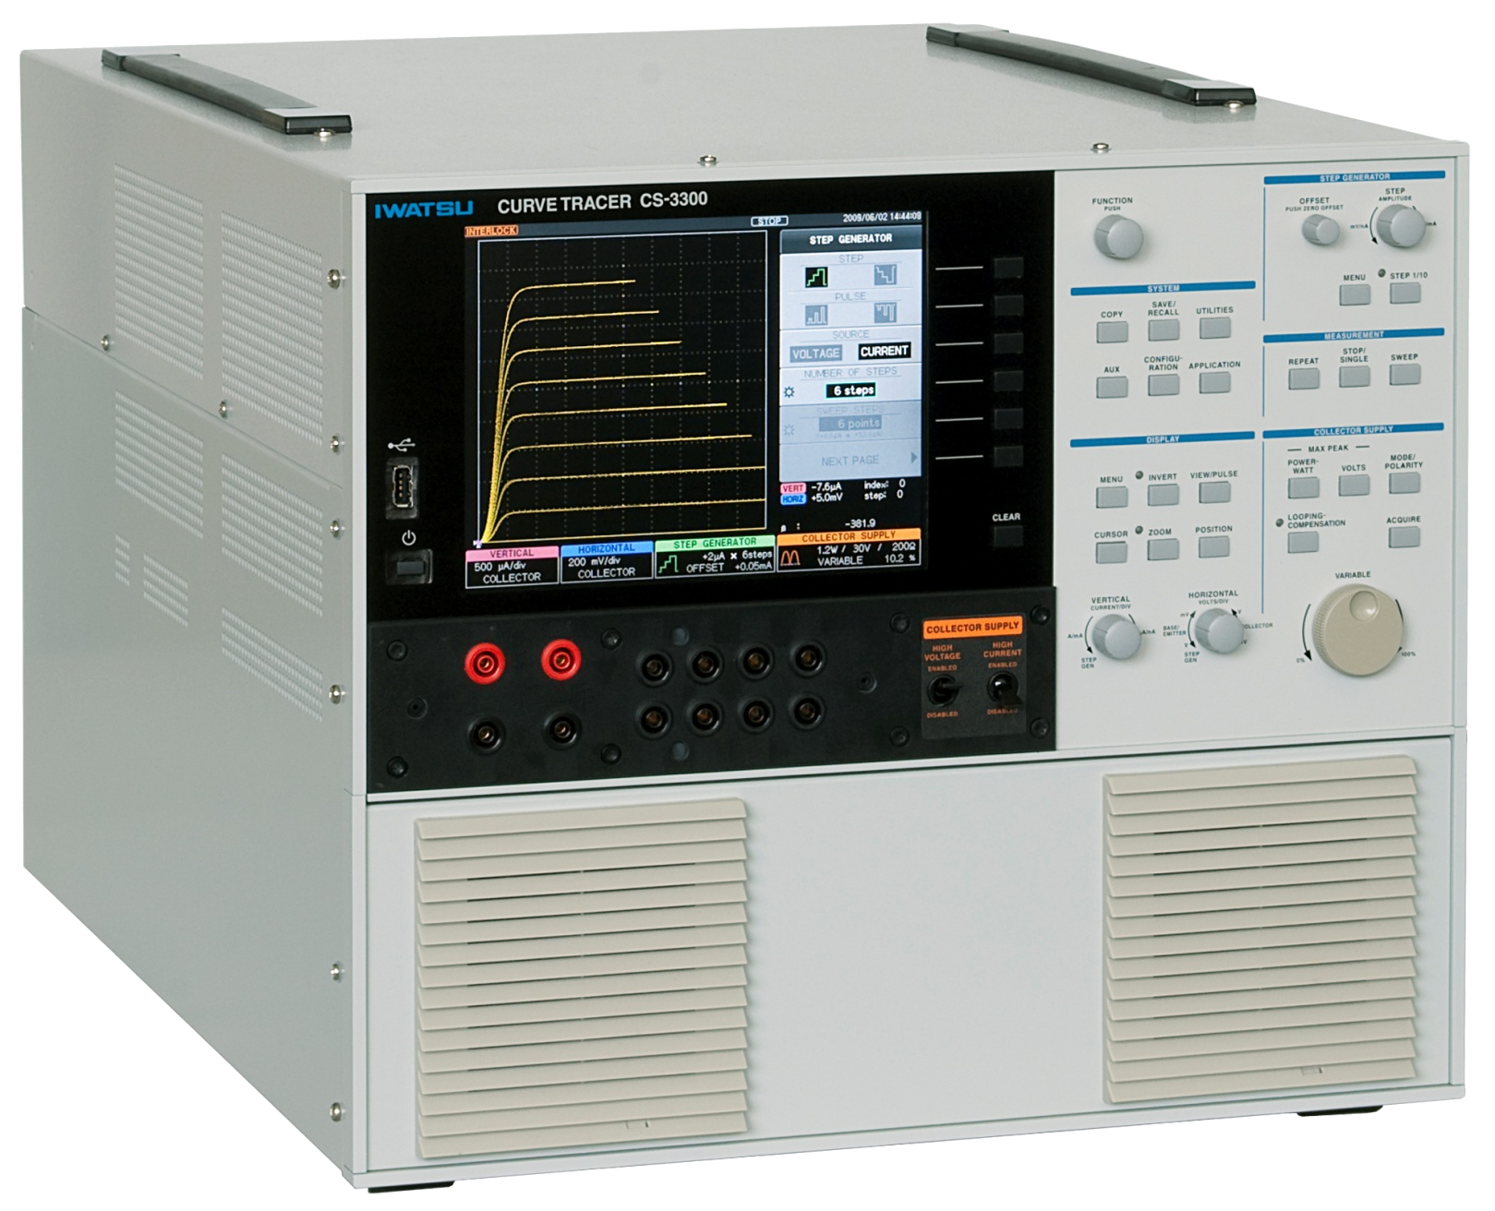
Outer looks of the model: CS-3200&CS-3300 curve tracers
－ Contribute to development of the power electronics – Curve tracer CS-3000 series

Slide 6
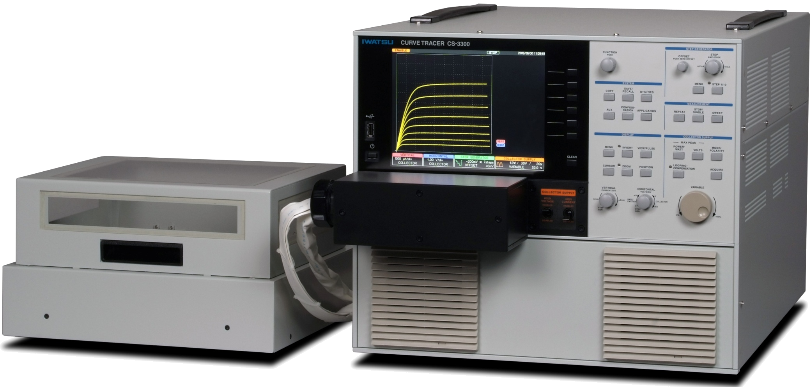
Configuration of CS-3000 series curve tracers
  ■ Standard configuration for model: CS-3200&CS-3300
Mainframe
Connection box for Fixture connection to mainframe
Fixture M(CS320)
Large current unit(not detachable)
Cable assembly
  ※ Measurement done with Specimen connected in the fixture
－ Contribute to development of the power electronics – Curve tracer CS-3000 series

Slide 7
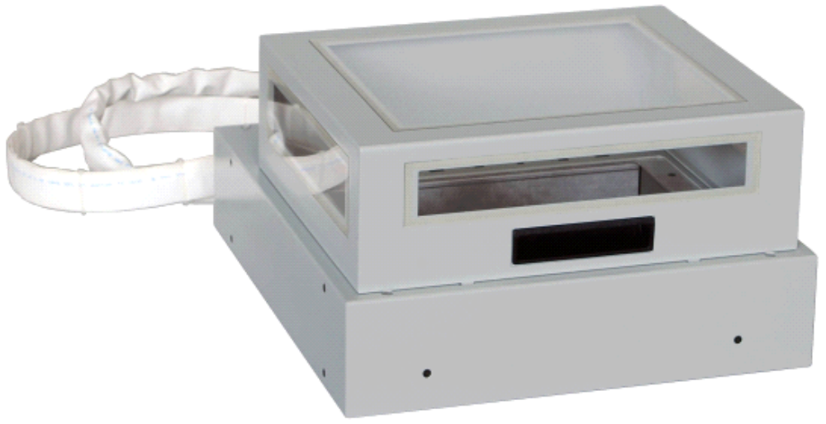
Fixture of CS-3200&CS-3300 curve tracers
Fixture M: CS-302
CS
-
3300
Cable length
１
ｍ
Protection Cover
181
mm
370
mm
330
mm
Measurement done after installation a specimen inside the fixture and covered
with “inter-rock” function for protection purpose
－ Contribute to development of the power electronics – Curve tracer CS-3000 series

Slide 8
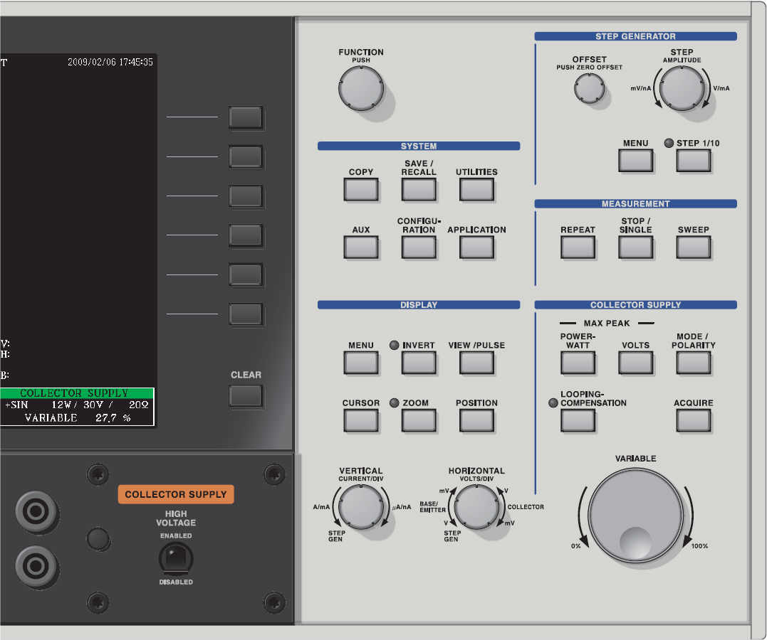
Front panel operation of CS-3000 series curve tracers
－ Contribute to development of the power electronics – Curve tracer CS-3000 series

Slide 9
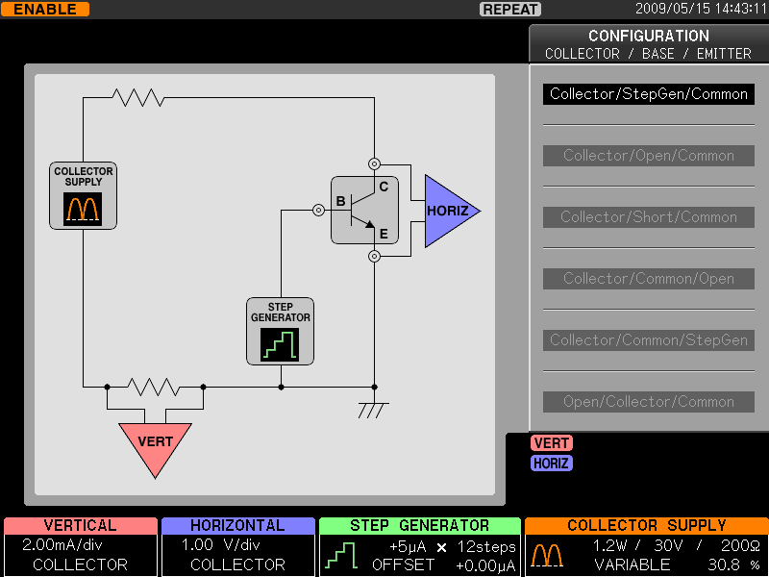
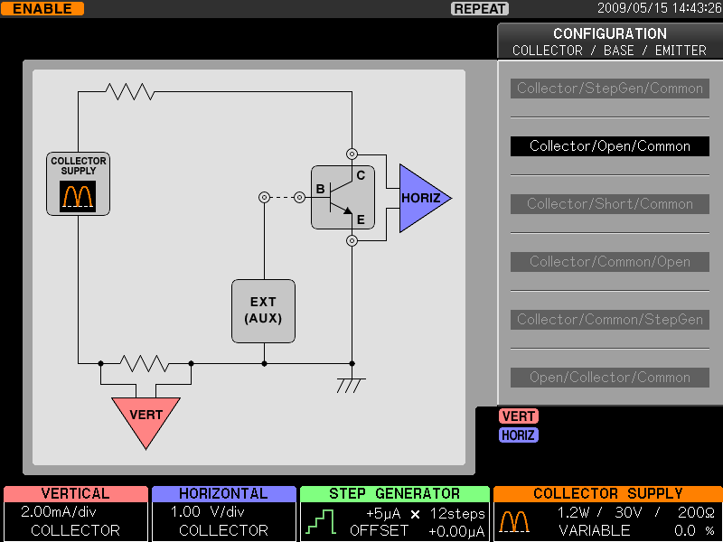
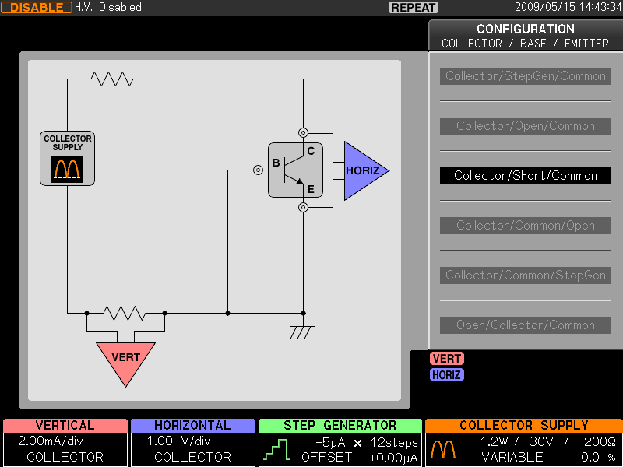
Unique function of CS-3000 series (previously not introduced!)
  ■ Graphical configuration block diagram for measurement modes
－ Contribute to development of the power electronics – Curve tracer CS-3000 series

Slide 10
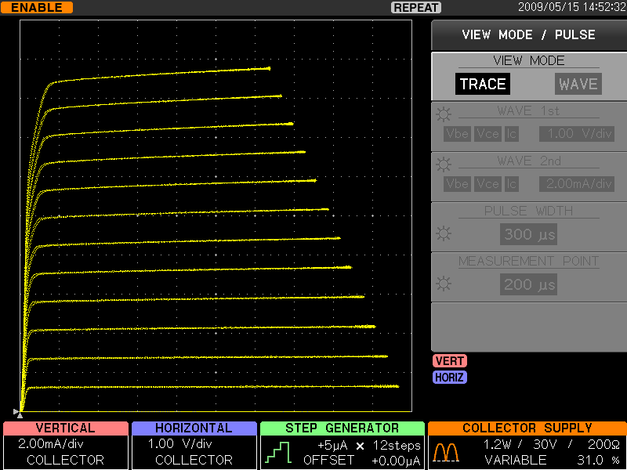
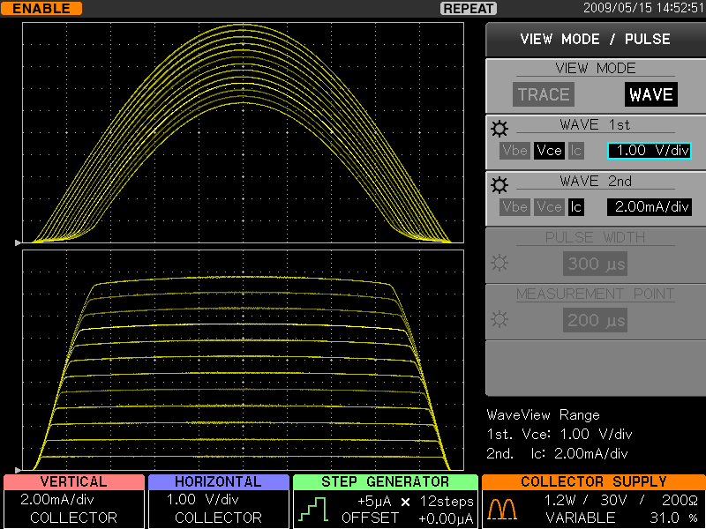
Unique function of CS-3000 series (previously not introduced!)
  ■ Two of viewing modes: TRACE & WAVE
－ Contribute to development of the power electronics – Curve tracer CS-3000 series

Slide 11
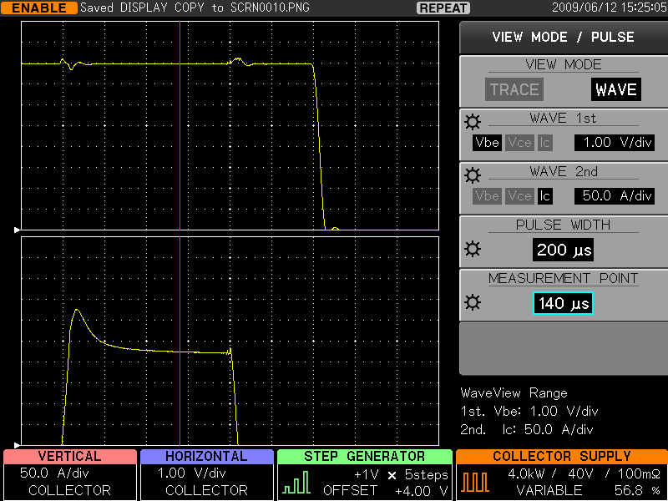
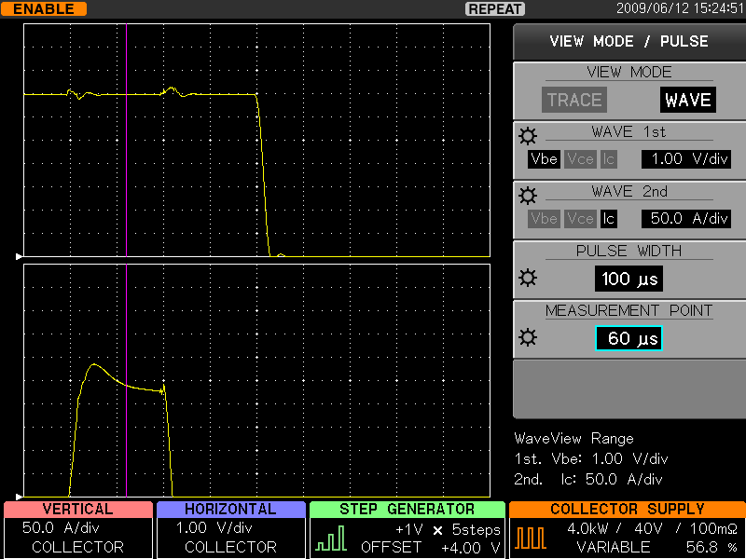
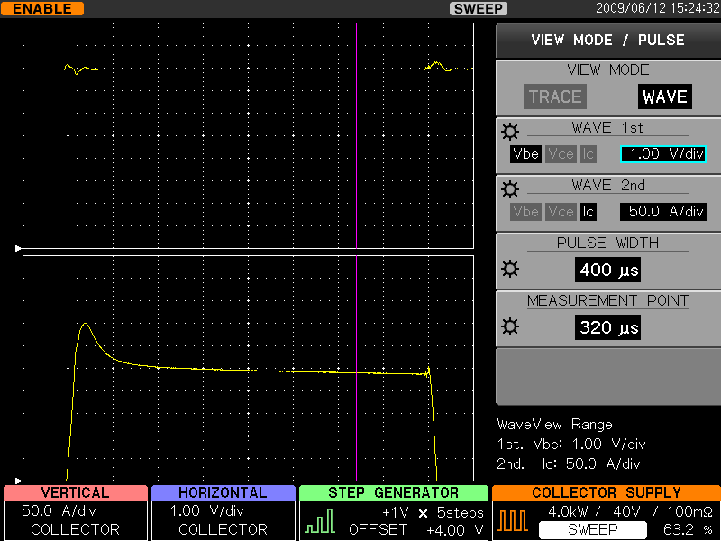
Unique function of CS-3000 series (previously not introduced!)
Large current mode: Output pulse: variable from 50μs to 400μs
Measurement points: 20points to 1,000points
Repetitive cycle: variable from 80msec to 1,000msec
－ Contribute to development of the power electronics – Curve tracer CS-3000 series

Slide 12
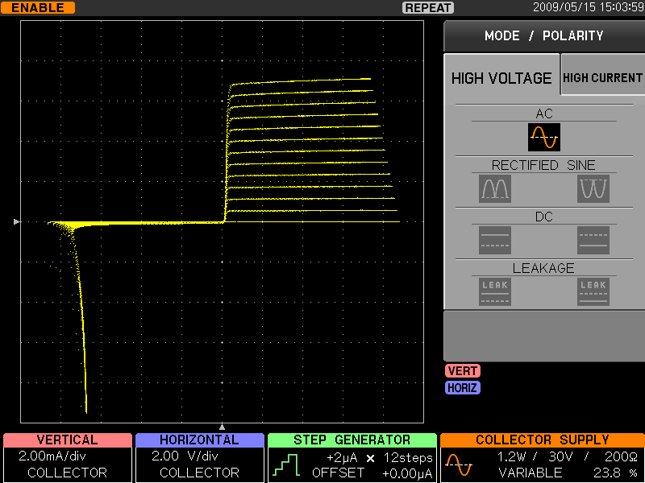
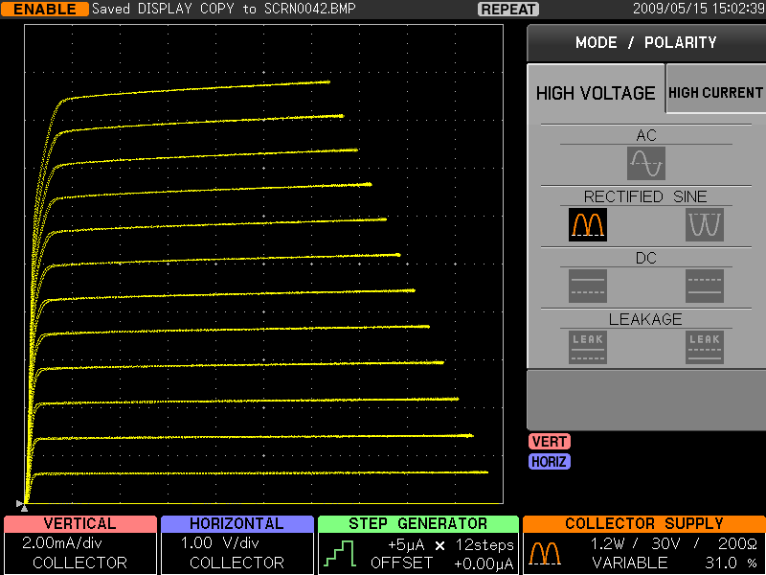
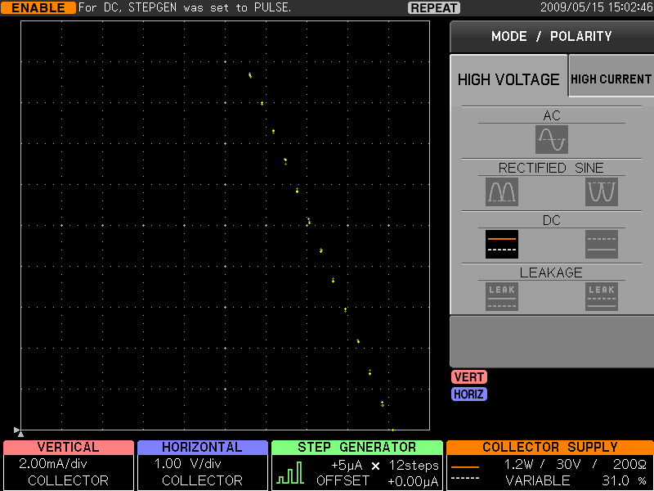
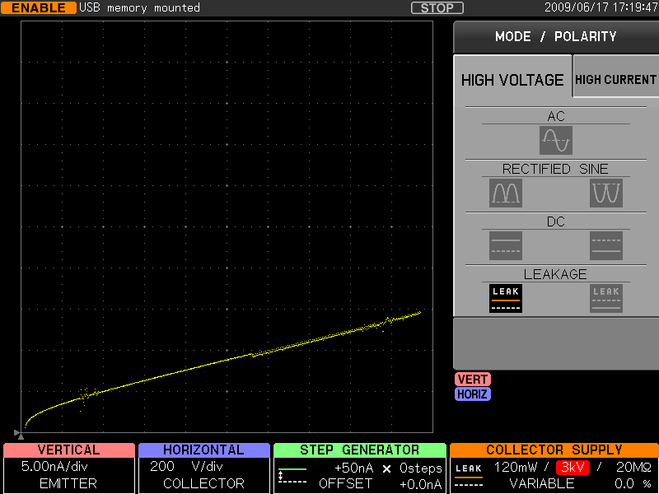
4 collector supply modes of CS-3000 series curve tracers
  ■ Collector supply modes: AC, +/-Full-wave rectify, +/-DC & +/-LEAKAGE
ＡＣ
＋Full-wave rectify
＋ＤＣ
＋LEAKAGE
－ Contribute to development of the power electronics – Curve tracer CS-3000 series

Slide 13
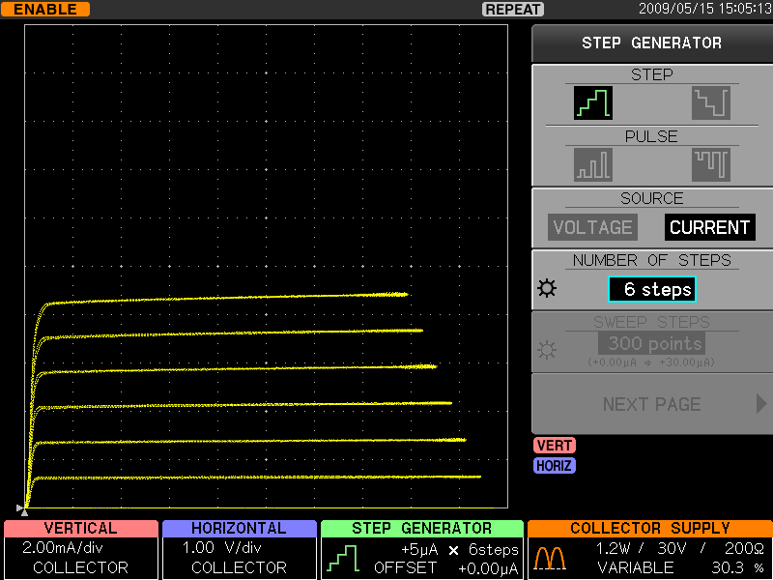
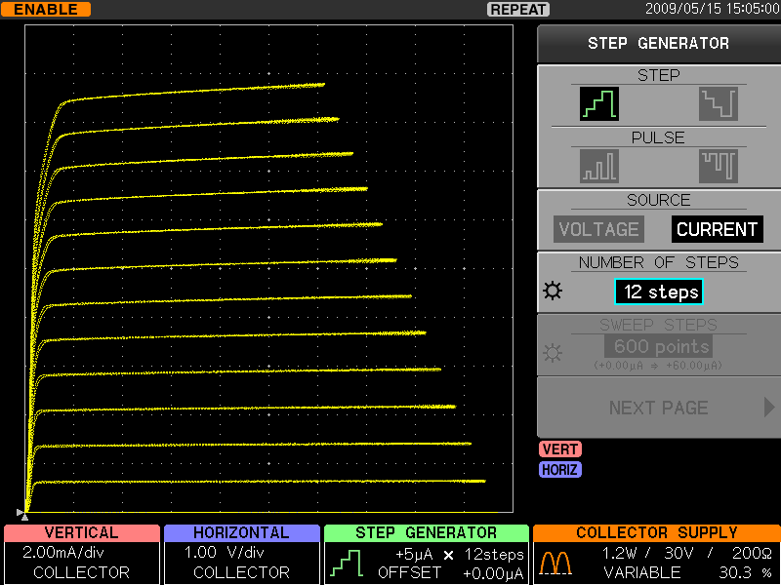
Maximum 20step measurement of CS-3000 series curve tracers
Available to set 0 to 20step for more efficient measurements
－ Contribute to development of the power electronics – Curve tracer CS-3000 series

Slide 14
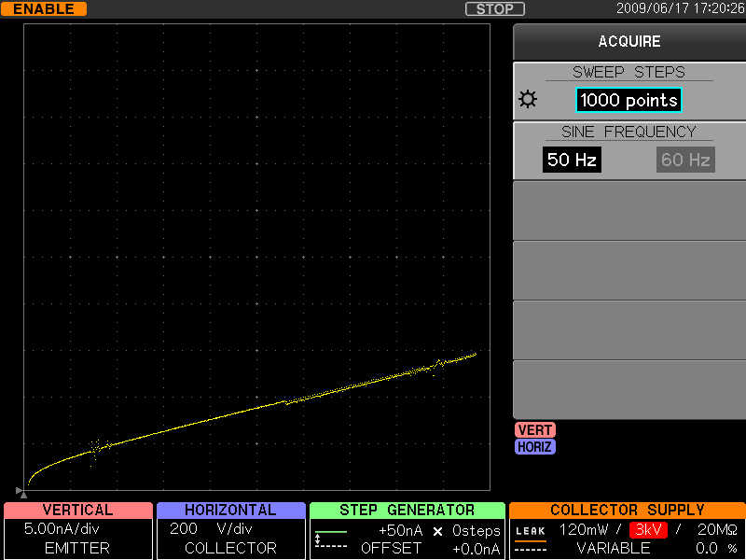
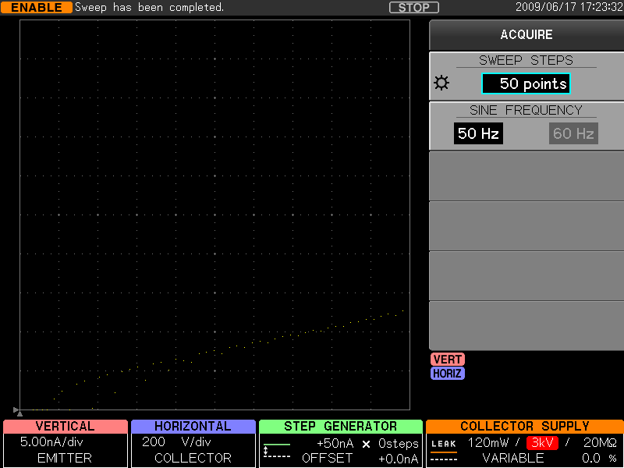
Sweep function of CS-3000 series curve tracers
Sweep at 1,000points
Sweep at 50points (less visible)
Maximum display points setting
from 20points up to 1,000points
for more efficient measurements
－ Contribute to development of the power electronics – Curve tracer CS-3000 series

